Slide 1
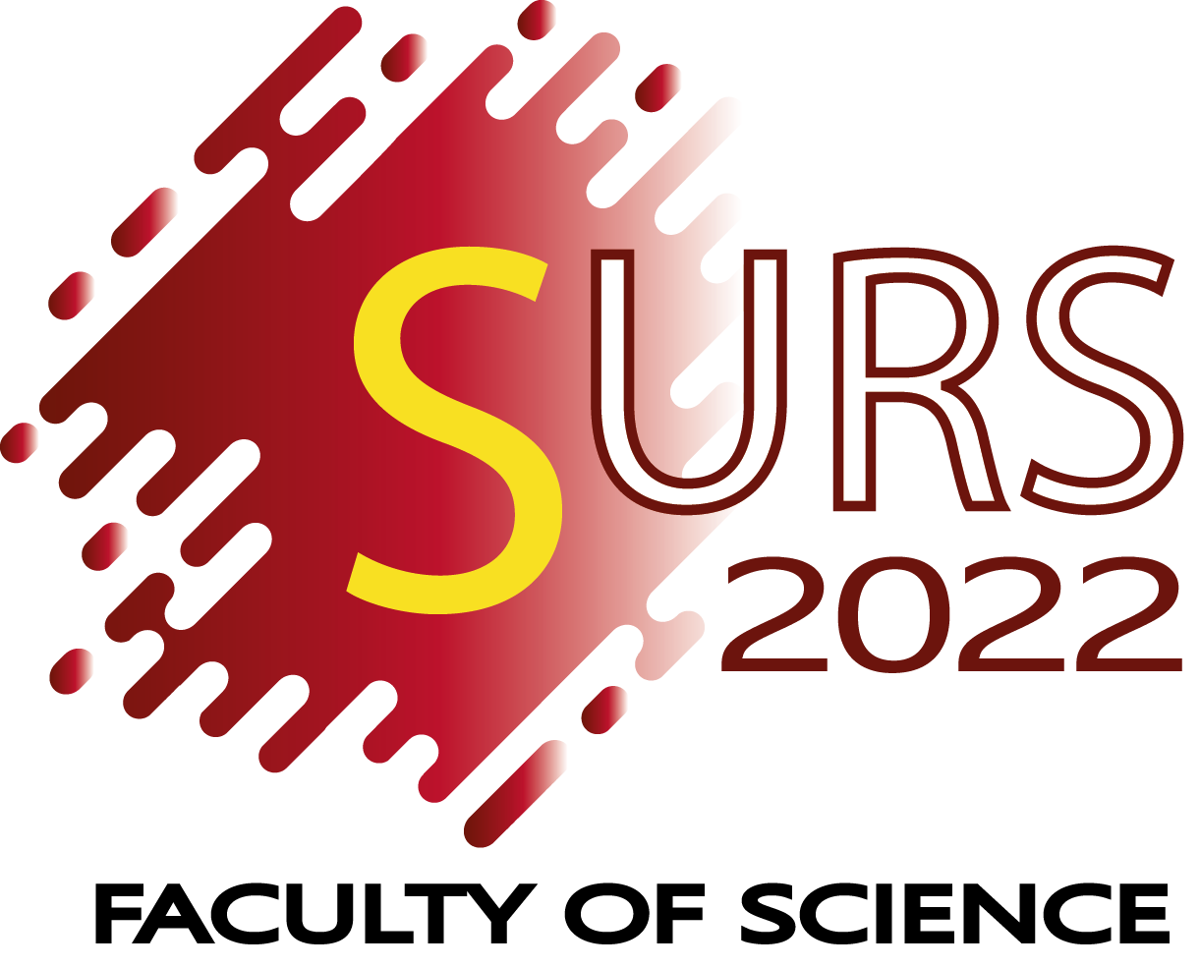
Environmental Science
2024
Artocarpus altilis (breadfruit) skin as a potential low-cost biosorbent for the removal of crystal violet dye: equilibrium, thermodynamics and kinetics studies
Oshada BANDARA
Department of Environmental Science
Faculty of Science
University of Peradeniya
October 11, 2024

Slide 2
Background and Aims
Research Questions/Hypothesis/Objectives

Slide 3
Results and Discussion

Slide 4
Conclusions & Future Directions

